Slide 1
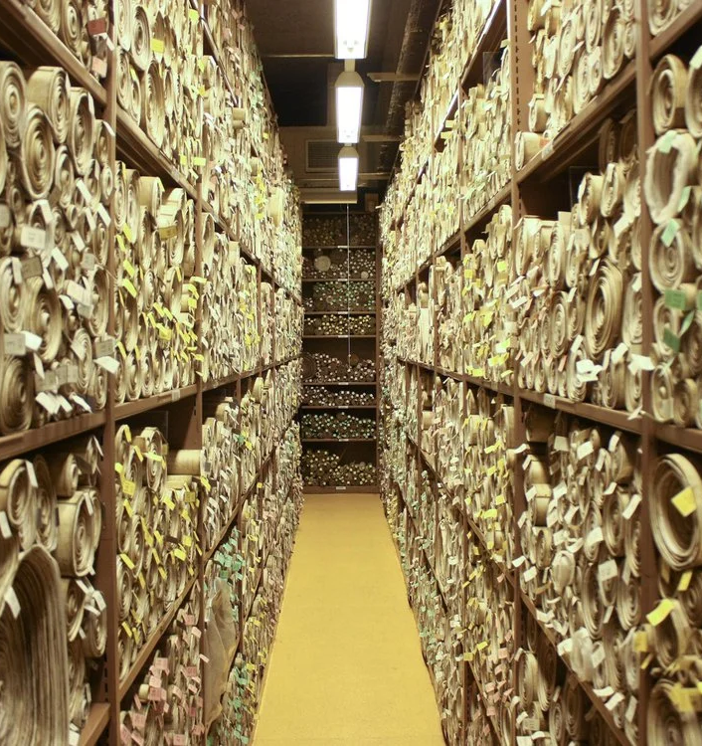
Smash Parliament
Turning vellum parchment into a tool for people wishing to follow the progress of bills

Slide 2
The Key Problem
Parliament bills are difficult to track

Slide 3
Identified Problems
It is difficult to
identify which bills are relevant to a specific topic
quickly understand the amendments that have occurred on that bill
follow and receive updates to relevant bills over time

Slide 4
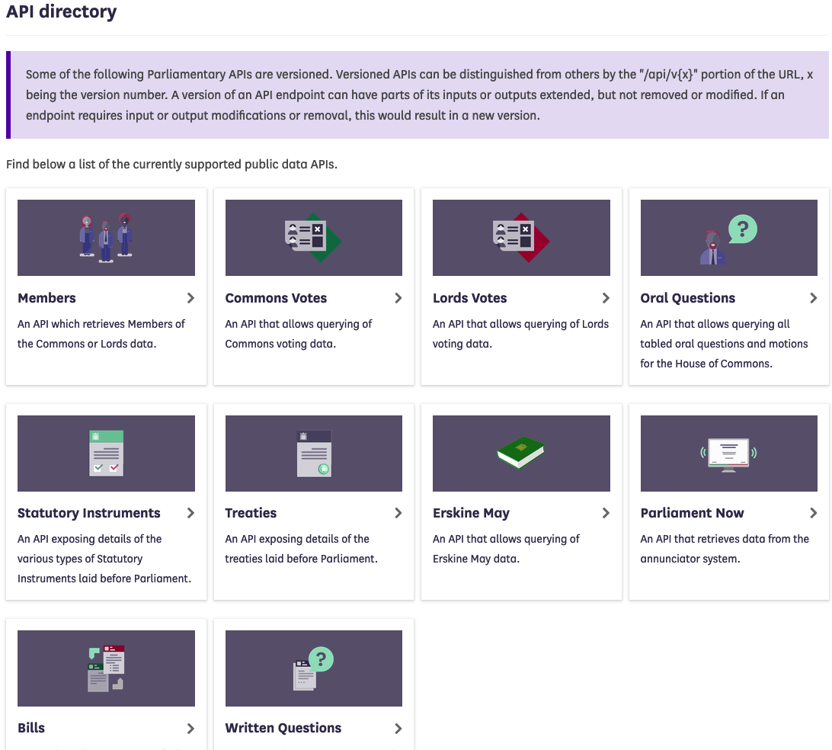
Parliament has an API (it’s a bit slow)
Good News:
Data is fairly well structured
Data is reasonably complete
Other Issues:
API is structured in a way that requires multiple calls

Slide 5
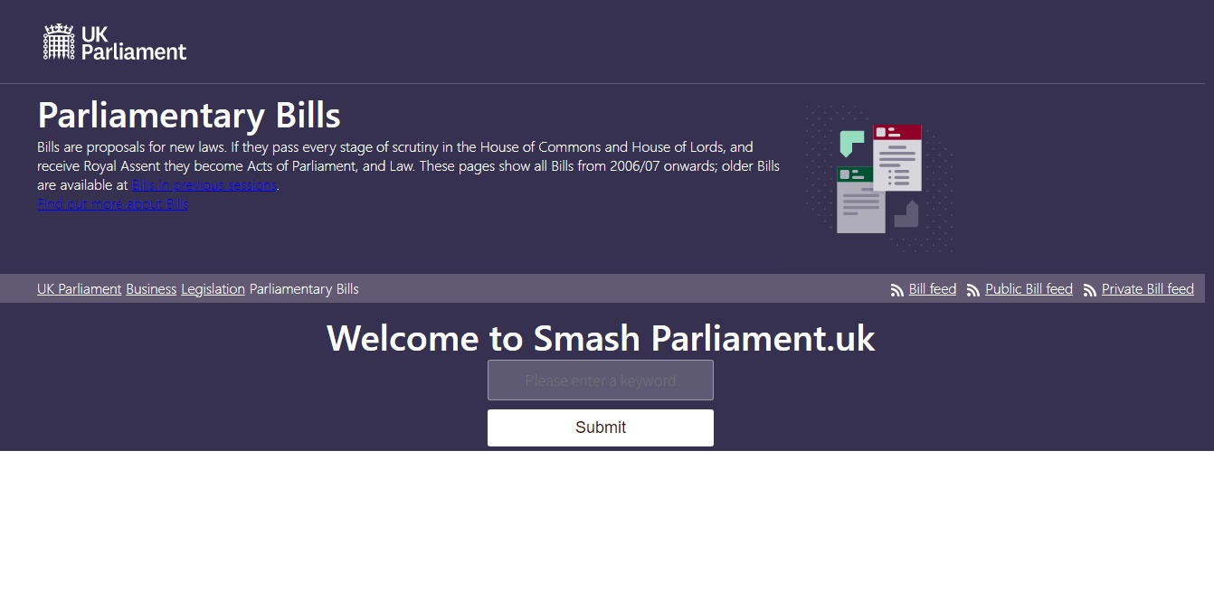
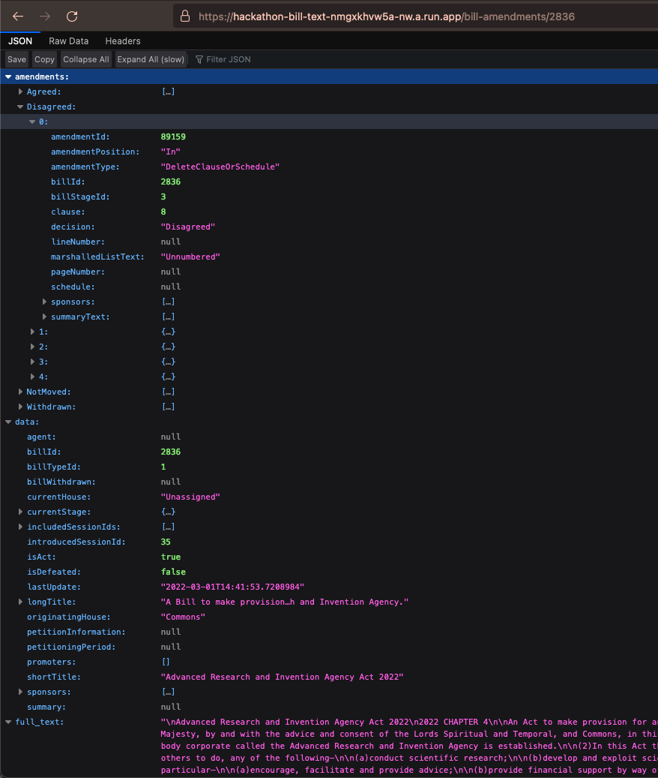
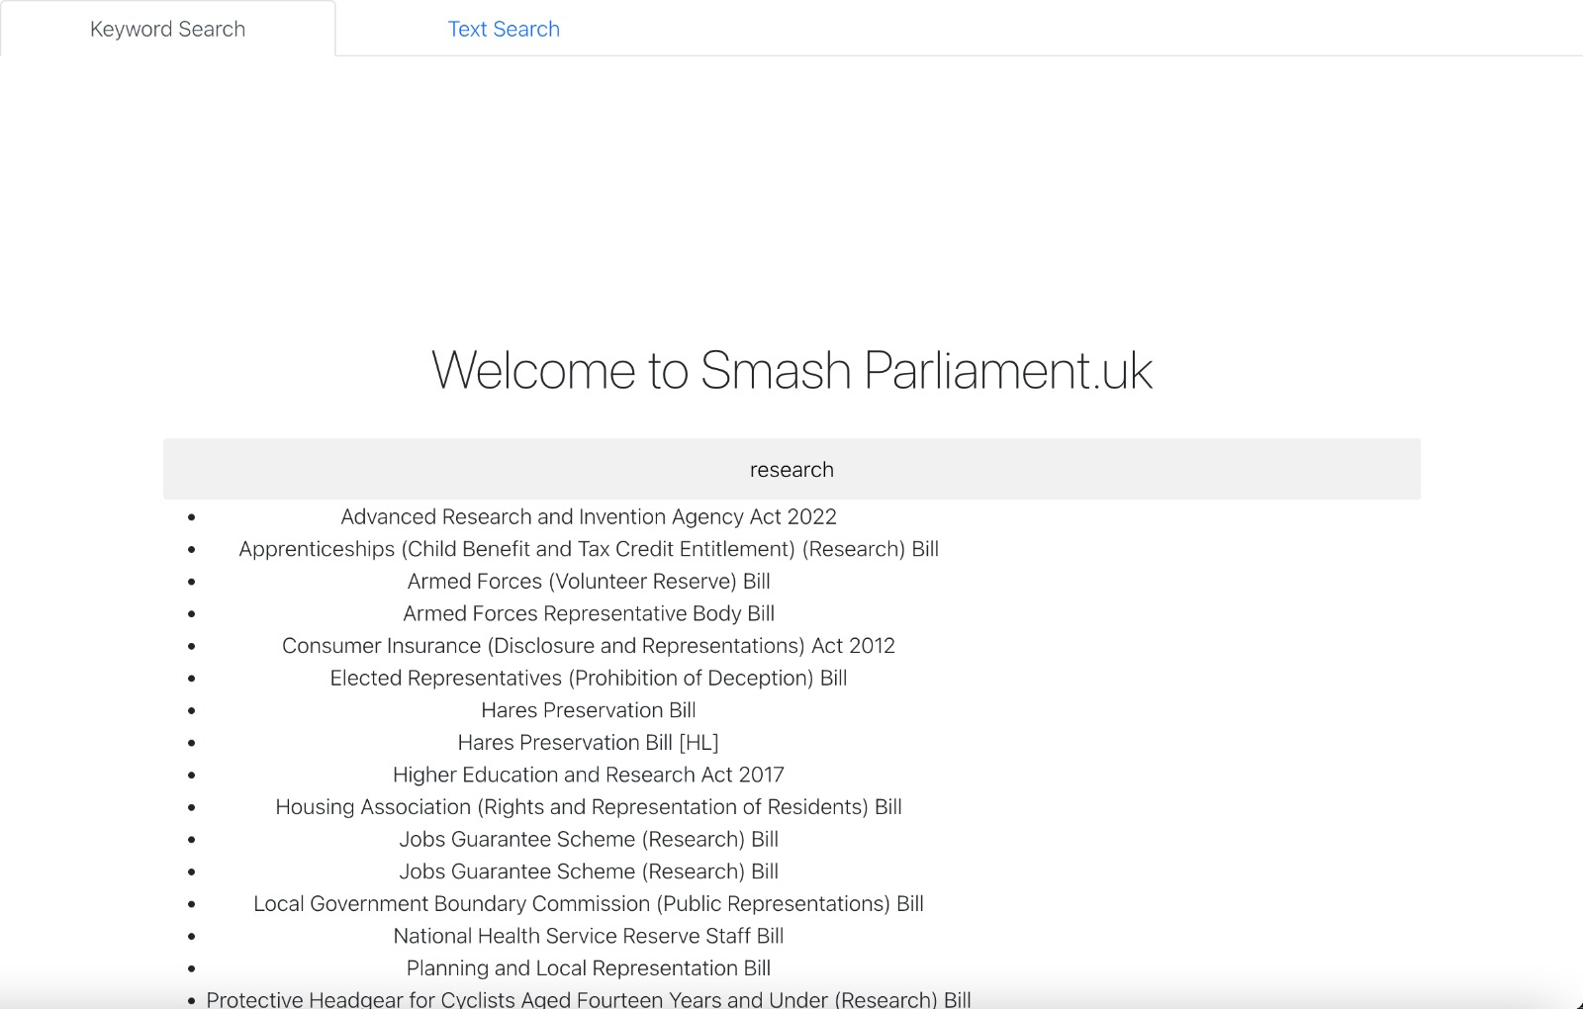
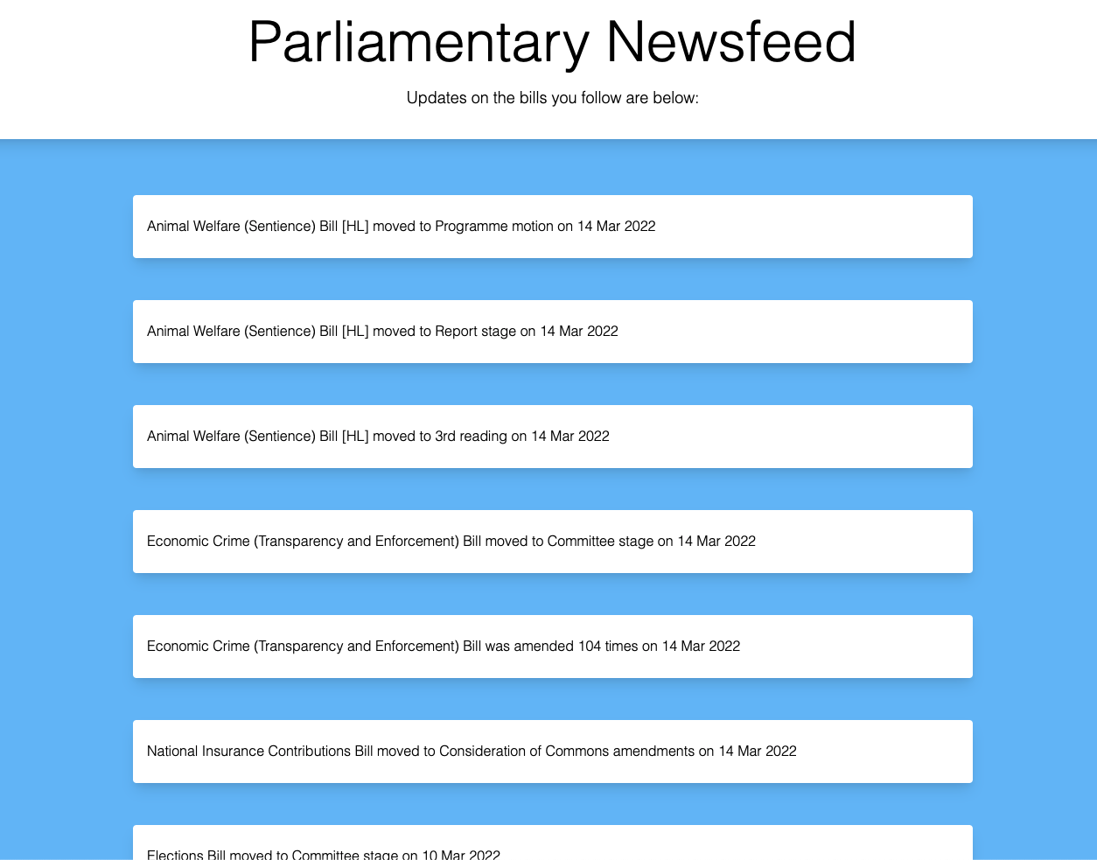
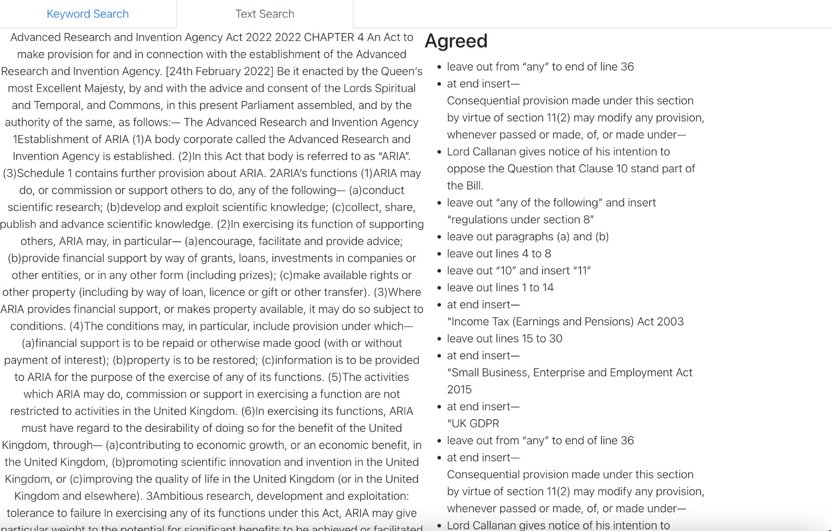
Our Tool
Up to date feed on the status of all bills
A live backend searching and classifying bills. Also, provides all amendments to date on the bill
Searchable bills and amendment analyser

Slide 6
Demos

